Slide 1
Enhancing pathogenicity prediction from structure
(with machine learning)

Slide 2
Introduction

Slide 3
Data
187 structures with 3454 variants of known significance
2346 expected to be pathogenic (clinvar)
1108 expected to be benign (gnomad)
Collected from the pdbmap database with:
Crystal structure has to be available with resolution <2.5Å and length between 100 and 450
At least 3 different benign and 3 different pathogenic variants
Benign variants need to have maf>0.0001
Conflict between variants: benign if maf>0.05, pathogenic otherwise
Only 1 chain per structure is used and only 1 structure per uniprot

Slide 4
Feature – ΔΔG

Slide 5
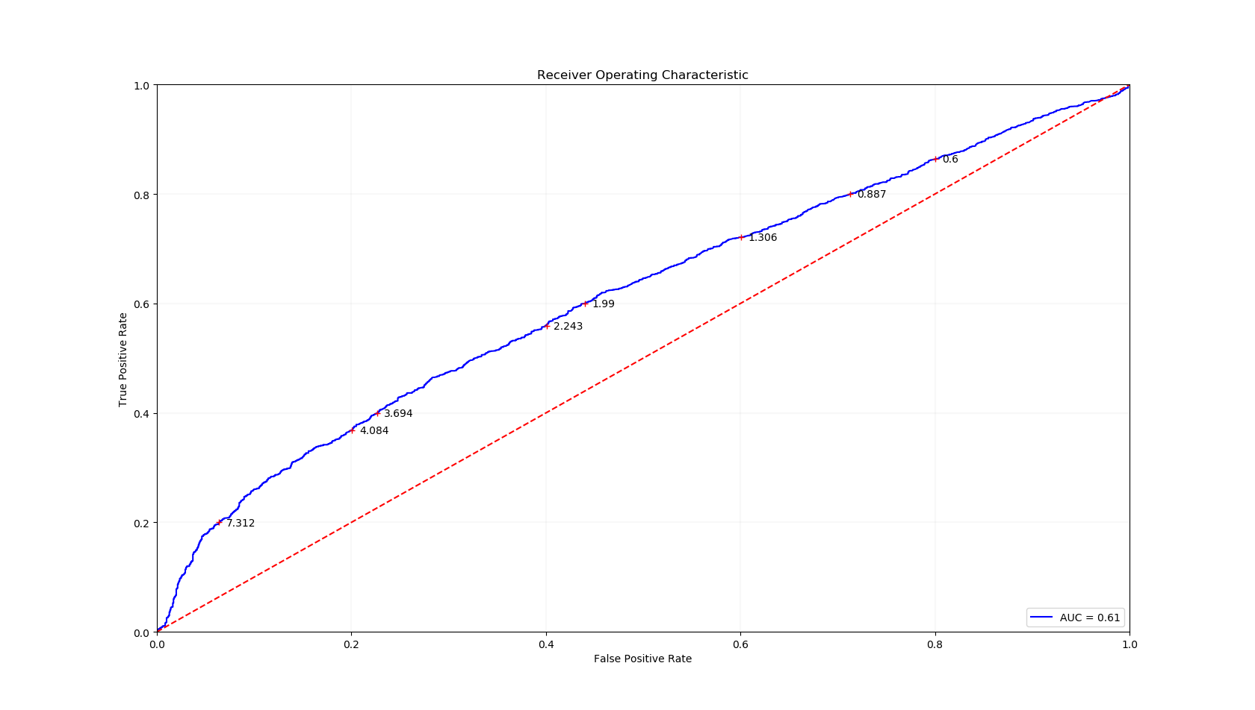
Feature – ΔΔG

Slide 6
Feature – Pathprox

Slide 7
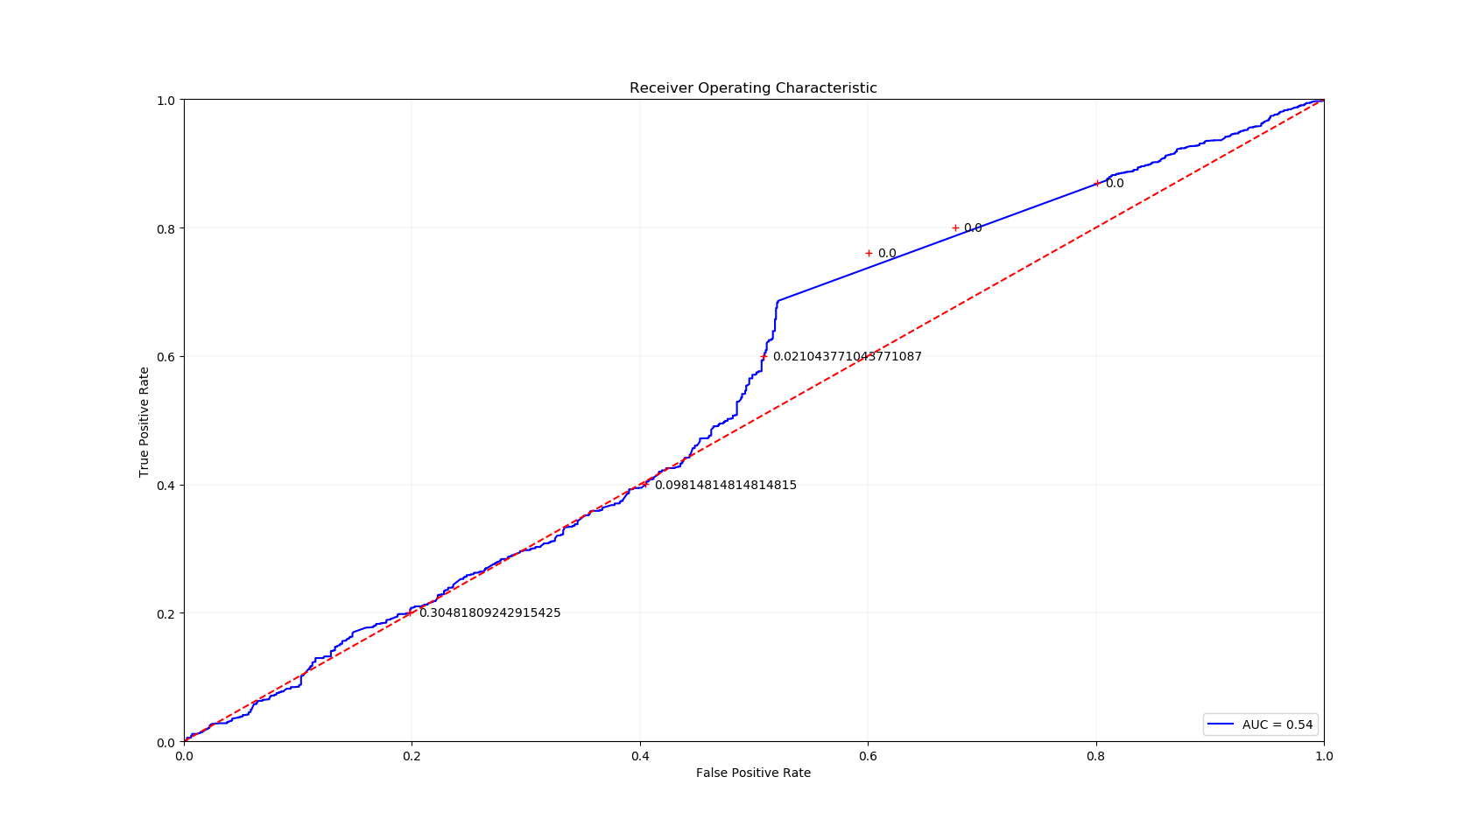
Feature – Pathprox

Slide 8
Feature – Uniprot Annotations

Slide 9
Feature – Uniprot Annotations
Molecule processing | Binding region | Amino acid modification | Covelant bonding | Sites
Transit peptide | Nucleotide binding | Modified residue | Disulfide bond | Binding site
Signal | Zinc finger | Lipidation | Cross-link | Metal binding
Initiator methionine | Calcium binding | Glycosylation |  | Active site
Propeptide | DNA binding |  |  | Site
 | Motif
Helix
Turn
Beta strand
Transmembrane regions
2838 annotations were suitable, 922 variants have none, 2230 have one, 298 have two and 4 have three

Slide 10
Feature – Uniprot Annotations
Molecule processing | Binding region | Amino acid modification | Covelant bonding | Sites
Transit peptide | Nucleotide binding | Modified residue | Disulfide bond | Binding site
Signal | Zinc finger | Lipidation | Cross-link | Metal binding
Initiator methionine | Calcium binding | Glycosylation |  | Active site
Propeptide | DNA binding |  |  | Site
 | Motif
Helix
Turn
Beta strand
Transmembrane regions
2838 annotations were suitable, 922 variants have none, 2230 have one, 298 have two and 4 have three

Slide 11
Feature – Uniprot Annotations
Molecule processing | Binding region | Amino acid modification | Covelant bonding | Sites
Transit peptide | Nucleotide binding | Modified residue | Disulfide bond | Binding site
Signal | Zinc finger | Lipidation | Cross-link | Metal binding
Initiator methionine | Calcium binding | Glycosylation |  | Active site
Propeptide | DNA binding |  |  | Site
 | Motif
Helix
Turn
Beta strand
Transmembrane regions

Slide 12
Feature – Uniprot Annotations
Molecule processing | Binding region | Amino acid modification | Covelant bonding | Sites
Transit peptide | Nucleotide binding | Modified residue | Disulfide bond | Binding site
Signal | Zinc finger | Lipidation | Cross-link | Metal binding
Initiator methionine | Calcium binding | Glycosylation |  | Active site
Propeptide | DNA binding |  |  | Site
 | Motif
Helix
Turn
Beta strand
Transmembrane regions
Added instead: Resolution and length of structure

Slide 13
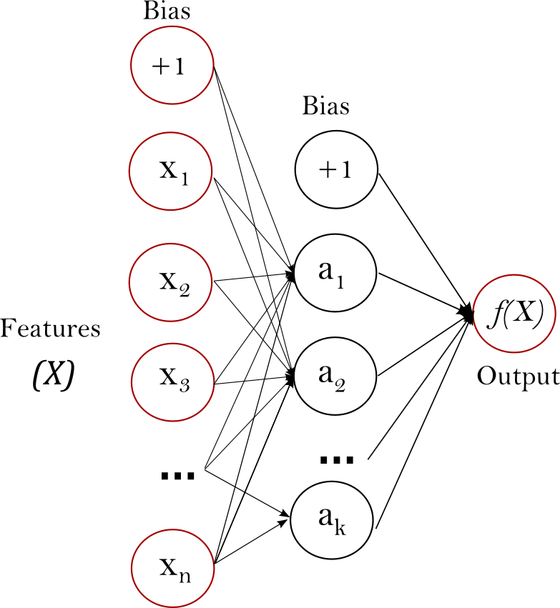
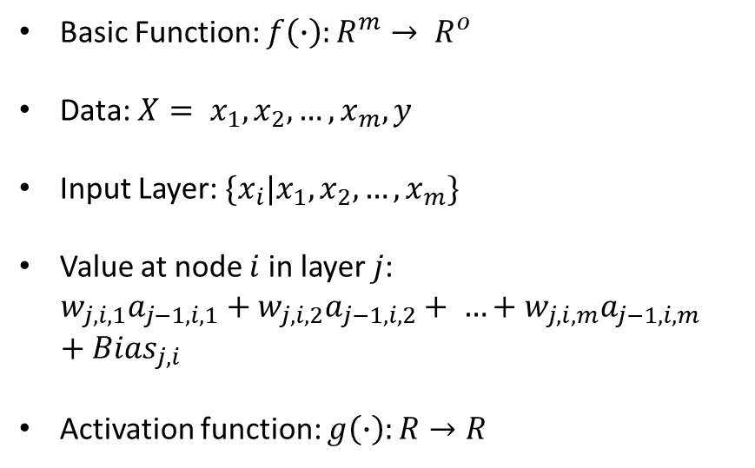
Classifier
Basic Function: $f\left(∙\right):R^{m}→ R^{o}$
Data: $X= x_{1},x_{2}, …,x_{m}, y$
Input Layer: $\{x_{i}|x_{1},x_{2}, …,x_{m}\}$
Value at node $i$ in layer $j$:
$$w_{j,i,1}a_{j−1,i,1}+w_{j,i,2}a_{j−1,i,2}+ …+w_{j,i,m}a_{j−1,i,m}+{Bias}_{j,i}$$
Activation function: $g\left(∙\right):R→R$
Source: https://scikit-learn.org/stable/modules/neural_networks_supervised.html

Slide 14
Classifier
Input needs to be scaled!
Source: https://scikit-learn.org/stable/modules/neural_networks_supervised.html

Slide 15
Classifier

Slide 16
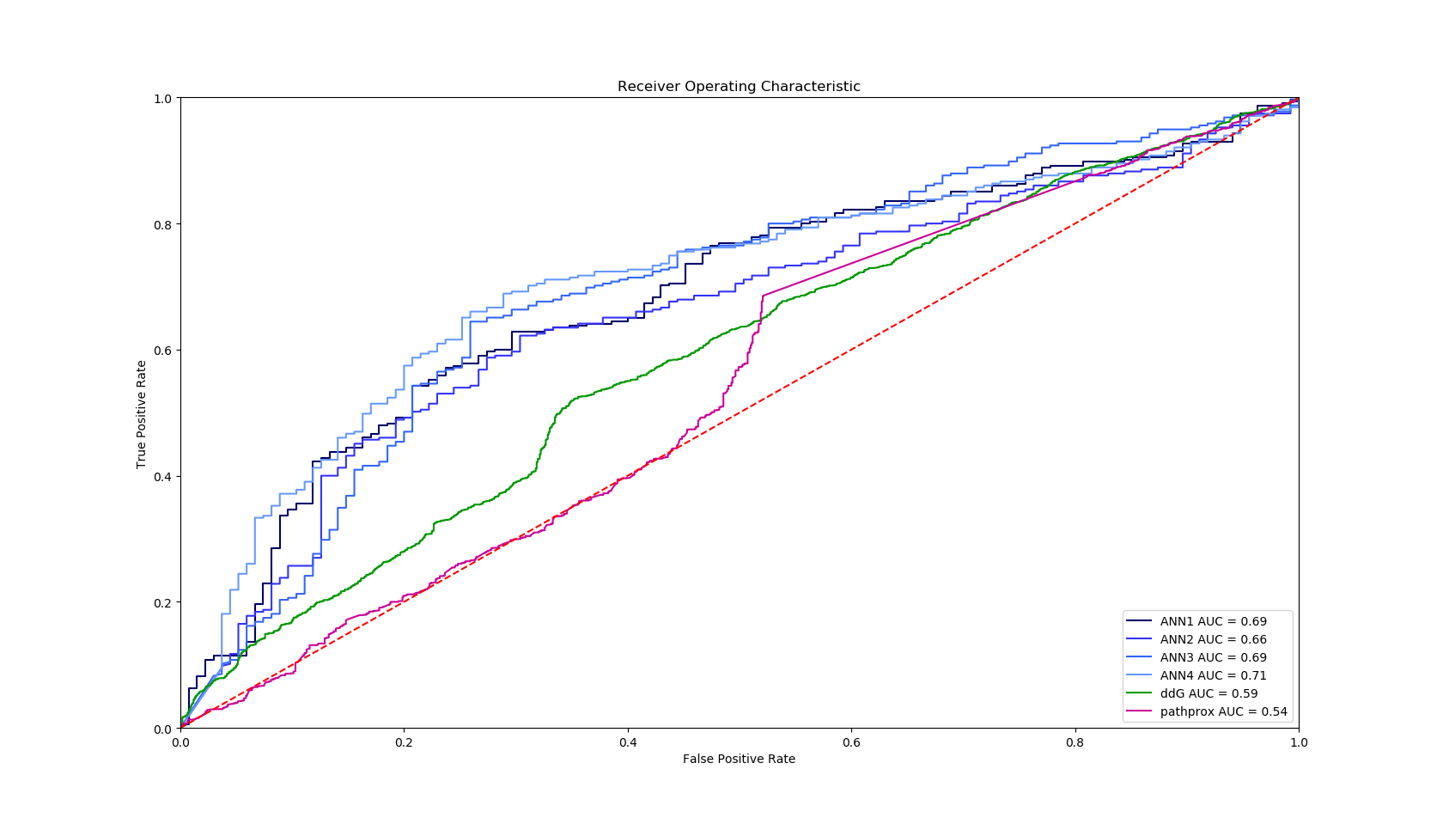
Classifier Training

Slide 17
Classifier Training

Slide 18
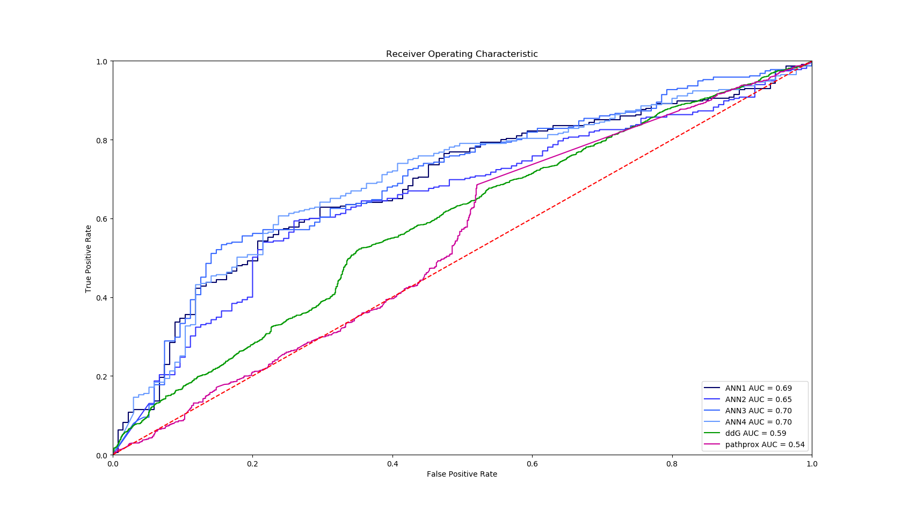
Classifier Training

Slide 19
Classifier 100_100_100_100_21000

Slide 20
Classifier 100_100_100_100_21000
Resolution | Length | ddG | pathprox | Beta strand | Binding region | Covalent bonding | Helix | Turn
0.464 | 0.347 | 0.535 | 0.579 | 0.502 | 0.506 | 0.485 | 0.579 | 0.503
0.585 | 0.805 | 0.44 | 0.333 | 0.503 | 0.497 | 0.535 | 0.333 | 0.491

Slide 21
Classifier 100_100_100_100_21000
Resolution | Length | ddG | pathprox | Beta strand | Binding region | Covalent bonding | Helix | Turn
0.464 | 0.347 | 0.535 | 0.579 | 0.502 | 0.506 | 0.485 | 0.579 | 0.503
0.585 | 0.805 | 0.44 | 0.333 | 0.503 | 0.497 | 0.535 | 0.333 | 0.491
Resolution | Length | ddG | pathprox | Beta strand | Binding region | Covalent bonding | Helix | Turn
0.313 | 0.24 | 0.359 | 0.39 | 0.339 | 0.339 | 0.328 | 0.39 | 0.34
0.363 | 0.436 | 0.317 | 0.286 | 0.337 | 0.338 | 0.348 | 0.286 | 0.336

Slide 22
Conclusion and discussion

